Slide 1
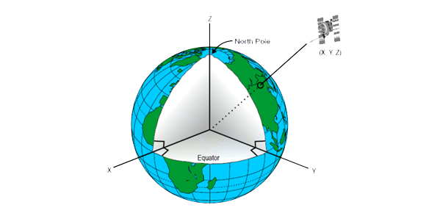
Spatial referencing and positioning
CHAPTER 4
Principles of Geographic Information Systems
An introductory textbook

Slide 2
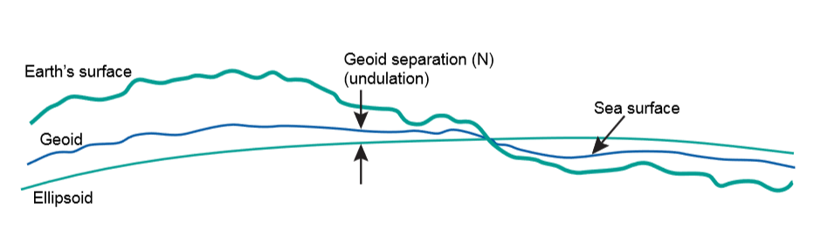
Reference Surface for mapping
Surface of the earth – not uniform
To approximate the surface of the earth, 2 reference surfaces are:-
  GEOID :- a hypothetical solid figure whose surface corresponds to mean sea level and its imagined extension under (or over) land areas.
  ELLIPSOID :- surface that may be obtained from a sphere by deforming it by means of directional scalings, or more generally, of an affine transformation.

Slide 3
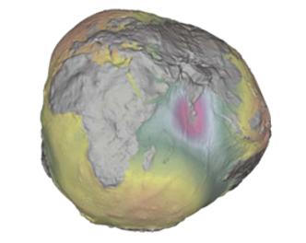
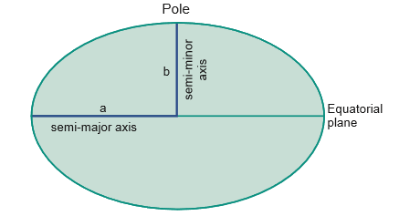
Geoid and ellipsoid

Slide 4
The Geoid and the vertical datum
Assumption:-
  Entire earth surface is largely covered by water
  Water surface is affected by gravity (ignoring tidal and current effects)
Therefore, direction of gravity (plumb line) is dependent on the mass distribution inside the earth
The plumb line through any surface point is always perpendicular to it.
Geoid is used to describe heights
For this, the ocean’s water level is registered using tide gauges (mareographs).
The registrations are averaged and are called mean sea level.
For eg:- For Netherlands and Germany, the local mean sea level is realized through the Amsterdam tide gauge (zero height).
The height of any point is determined through a technique called as geodetic levelling,
The height determined with respect to tide gauge is known as orthometric height.

Slide 5
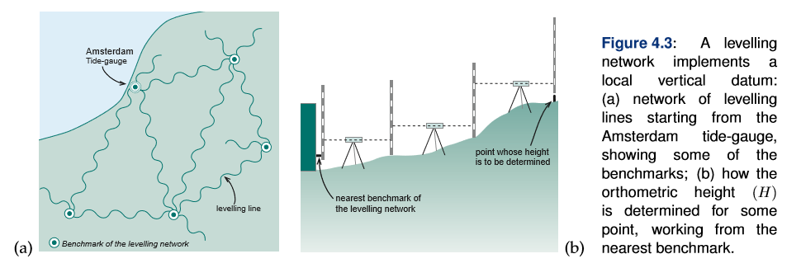
The Geoid and the vertical datum
The local vertical datum is implemented through a levelling network.
A levelling network consists of benchmarks whose height above mean sea level has been determined through geodetic levelling.
So, the surveyors need not start from the beginning everytime they need to determine the height of a new point.

Slide 6
The ellipsoid
Reference surface for heights – geoid
Reference surface for horizontal co-ordinates – oblate ellipsoid
An ellipsoid is formed when an ellipse is rotated about its minor axis

Slide 7
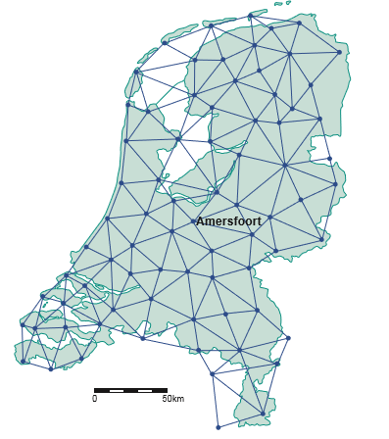
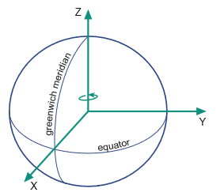
Local and Global horizontal datum
Local Horizontal Datum
  latitude and longitude
  Realised through a triangulation network
  The angles in each triangle are measured along with a fundamental point in the triangle
  The angle measurement along with the point co-ordinates are used to derive the geographic co-ordinates i.e latitudes and longitudes
Global Horizontal Datum – (X,Y,Z)

Slide 8




Co-ordinate Systems
Spatial :- are used to locate data either on the Earth’s surface in a 3D space or Earth’s reference surface on 2D space
Planar:- are used to locate data on a flat surface of a map in a 2D space.

Slide 9
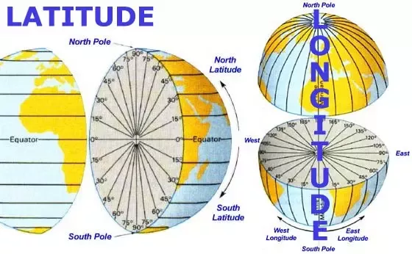
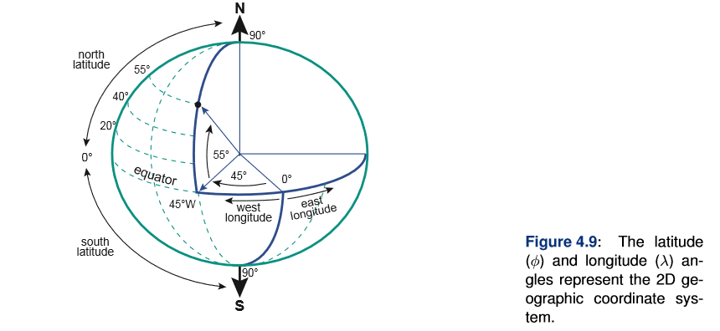

Slide 10
Latitude denoted by phi; Longitude denoted by lambda
Lines of equal latitudes – parallels; they form circles on the surface of the ellipsoid
Lines of equal longitudes – meridians; they form ellipses on the ellipsoid
The latitude of a point P is the angle between ellipsoidal through the point P and the equatorial plane; Latitude is 0 on the equator; max value is +90 degrees at North Pole and -90 degrees at South Pole.
The longitude of a point P is the angle between the meridian ellipse which passes through Greenwich and the meridian ellipse containing the point
It is measured in the equatorial plane from the meridian of Greenwich (it is zero), eastwards +180 degrees and westwards -180 degrees.

Slide 11
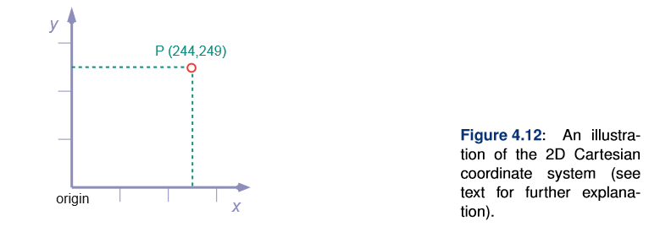
A flat map has only two dimensions: width (L-R) and length (B-T)
Also called planar rectangular coordinates.
X and Y Axis ; origin is x,y=0 and map grid is the equally spaced coordinate lines

Slide 12
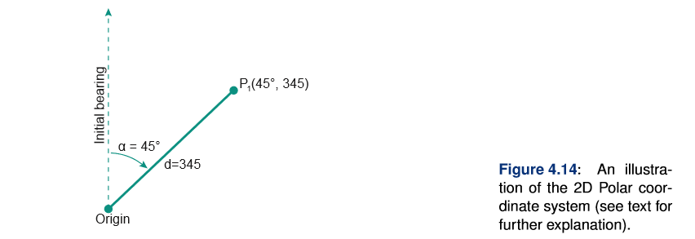
This is the distance d from the origin to the point concerned and an angle between a fixed direction and the direction to the point. It is given in length units.
This angle is called bearing and is measured in clockwise direction.It is given in angular units.

Slide 13
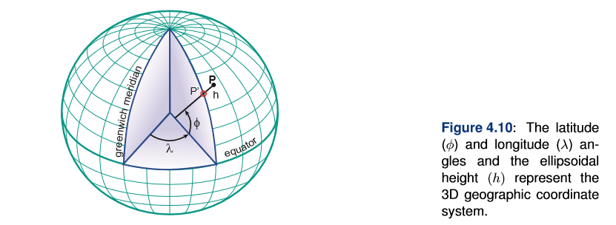
Latitude,Longitude ,ellipsoidal height h
H of a point is the vertical distance of the point above the ellipsoid
This coordinates can be used to define a position on the surface of the earth

Slide 14
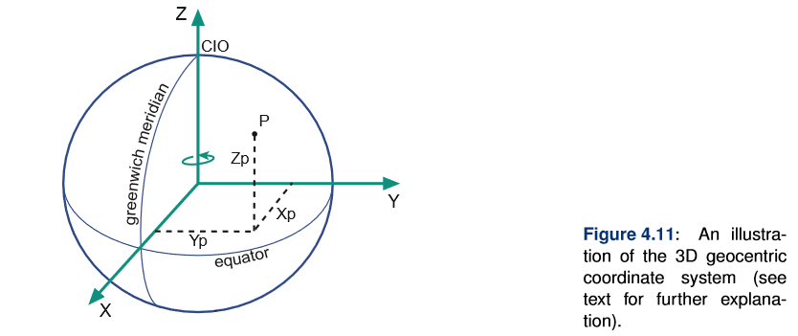
Also called 3D Cartesian Coordinates
Origin is the center of the earth; X-Axis passes through the meridian of Greenwich;Y-Axis in the plane of the equator; Z-Axis coincides with the Earth’s axis of rotation

Slide 15


Map Projection
Is a mathematically described technique of how to represent the Earth’s curved surface on a flat map.
The curved horizontal reference scale mapped onto a 2D mapping plane
Reference surface for large scale mapping:- oblate ellipsoid
Reference surface for small scale mapping:- a sphere
Mapping onto 2D means transforming each point on the reference surface with geographic coordinates to a set of cartesian coordinates(x.y)
This is achieved through mapping equations
A forward mapping equation
An inverse mapping equation

Slide 16
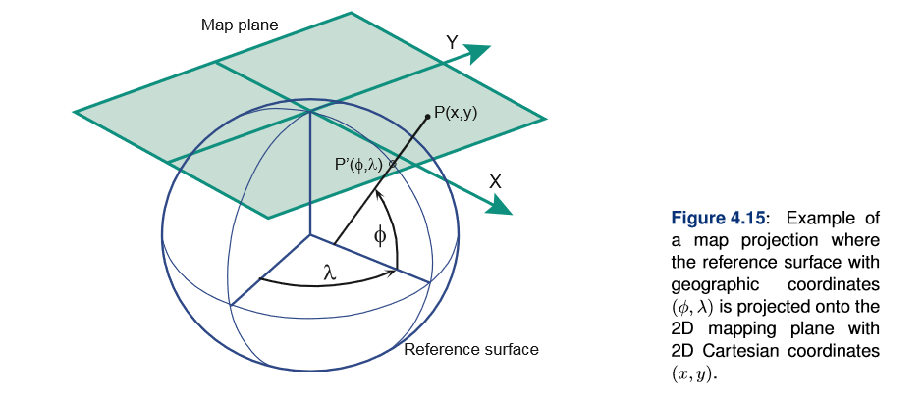

Slide 17
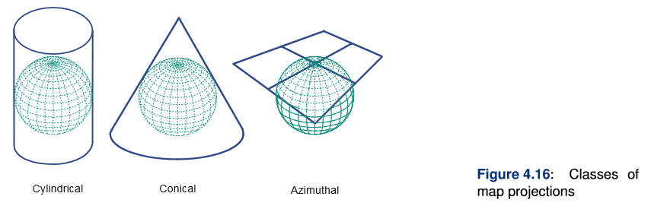
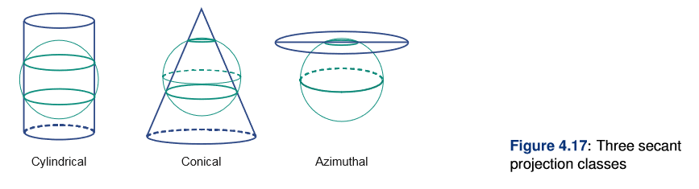
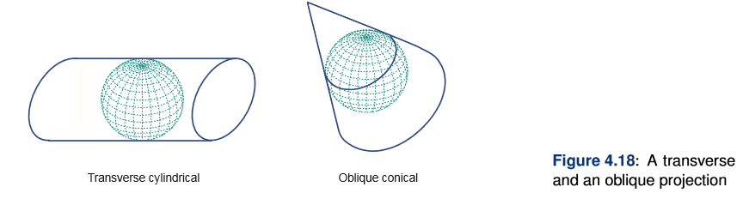

Slide 18
Satellite Based Positioning
Importance of satellites in georeferencing
  Realize geocentric reference systems
  Increase the level of spatial accuracy
Need for developing positioning system
  Military Use
  Low cost equipment with low energy consumption at the receiver’s end.
  Provision of real time results for unlimited number of users concurrently
  Different levels of accuracy(military v/s civilian)
  Around the clock
  Weather forecast
  Use of single geodetic datum

Slide 19
Satellite Based Positioning
Requires implementation of 3 hardware segments
  Space segment (satellites and the radio signals they emit)
  Control Segment (Ground stations that monitors space segment)
  User Segment (Users with hardware and software who conduct positioning)
Central problem:- To determine values (X,Y,Z) of the receiver that receives satellite signals i.e to determine the position of the receiver with stated accuracy and precision.

Slide 20
Absolute Positioning
Working:-
A satellite equipped with a clock, at a specific moment sends a radio message that includes i) the satellite identifier, ii)the position in orbit and iii) its clock readings.
A receiver,also equipped with a clock, receives the message slightly later, and reads its own clock.
From the time delay observed between 2 clock readings and knowing the speed of transmission between satellite and the receiver, the receiver can compute the distance to the sender, called the satellite’s pseudorange.
Satellite clocks and receiver clocks are not synchronized.
Differences in time reading between receiver and satellite clocks
Variable: (X,Y,Z, t)

Slide 21
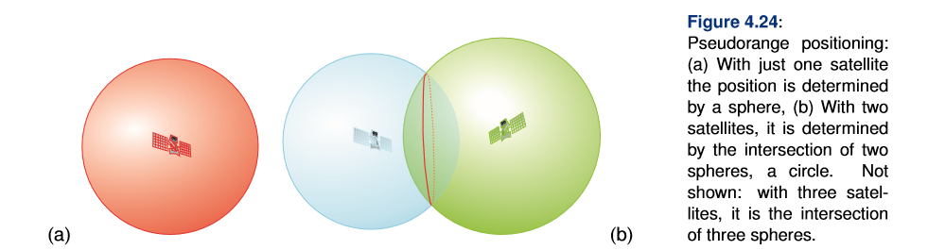
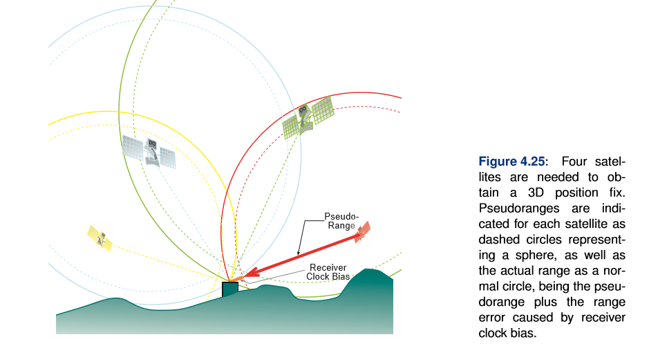

Slide 22
Time, Clocks and World Time
Position of sun in the sky
Time Zones – 24 geographic strips between certain longitudes that are multiples of 15 degrees.
GMT – Greenwich Mean Time – a system based on mean solar time at the meridian of Greenwich, UK – conventional 0-meridian
GMT replaced by UT – Universal Time based on the meridian crossing of stars.
Co-ordinated Universal Time (UTC) – is used in satellite positioning and is maintained with atomic clocks.

Slide 23
Errors in Absolute Positioning
Errors related to space segment
  Selective availability
  Incorrect information
    Incorrect clock reading:- A clock reading that is off by 0.000001 sec causes an error in the satellite’s pseudorange of approximately 300m
    Incorrect orbit position:- The orbit is easy to describe if both bodies are considered as point masses. In reality, they are not stationary and there are disturbances due to solar and lunar gravitation.
Control segment in the ground controls the errors
If unacceptable errors found, a satellite is labelled unhealthy.

Slide 24
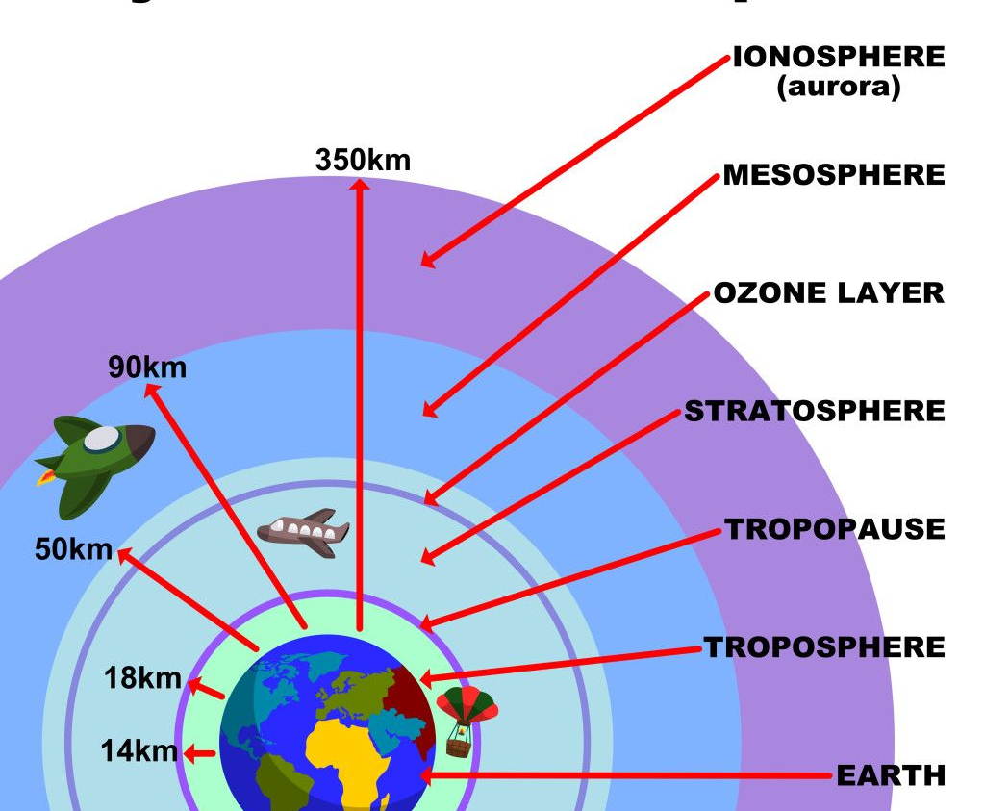
Errors in Absolute Positioning
Errors related to medium
  Stratosphere and mesosphere are harmless
  Troposphere:- approx. 14 km high just above the surface of the earth. It holds atmospheric oxygen and delays radio waves.
  Ionosphere:- outward part of the atmosphere that starts at an altitude of 90 km. It holds many electrically charged atoms, forms protection against various forms of radiation from space.

Slide 25
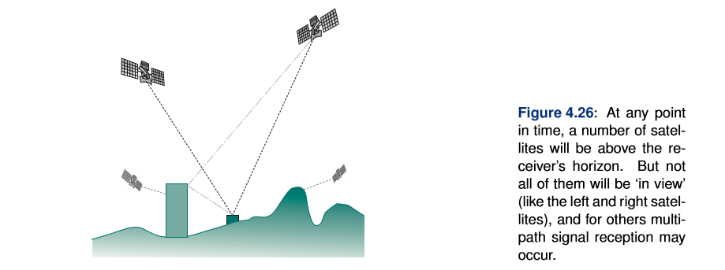
Errors in Absolute Positioning
Errors related to receiver’s environment

Slide 26
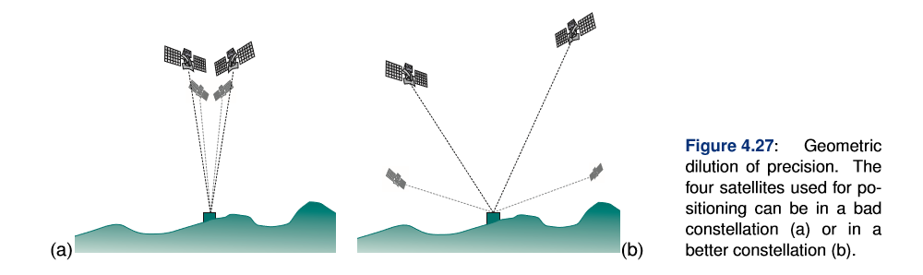
Errors in Absolute Positioning
Errors related to relative geometry of satellites and receiver – GDOP error

Slide 27
Relative Positioning
Solution for errors in absolute positioning:- Perform many position computations and determine the average over solutions
This will address random errors like signal noise, selective availability,multipath to some extent; but not address systematic errors like incorrect satellite data, atmospheric delays and GDOP effects.
Reference receiver and target receiver; 70-200 km apart
Reference receiver will determine its pseudorange error.
Target receiver will apply the corrections for each of the four satellite signals that it uses for positioning.
Inverted relative positioning:- Target receiver does not correct the error, but uses its data link to upload its positioning/timing information to a central repository where corrections are applied. Not useful where many target receivers are needed

Slide 28
Network Positioning
An integrated, systematic network of reference receivers covering a large area like the whole globe.
Network of reference stations – each monitoring the signals and their errors.
One/more control centers receive the reference station data,verify the correctness and relay this information to a geostationary satellite.
This satellite will retransmit the correctional data to the area it covers.
Target receivers in that area correct the errors and obtain accurate position fixes.

Slide 29
Positioning Technology
GPS
GLONASS
Galileo

Slide 30
GPS
NAVSTAR Global Positioning System – 1994 - American
Providing PPS (Precise Positioning System) to military and US govt agencies and SPS (Standard Positioning System) to civilians throughout the world.
Space segment - 24 satellites – each orbit our planet at an altitude of 20200 km.
These satellites are organized in six orbital planes, with an angle of inclination of 55-63 degrees with the equatorial plane, normally having 4 satellites each.
This means the receiver on earth will have between 5-8 satellites in view at a point of time.
Control segment – master control in Colorado,US and monitor stations in a belt around the equator.
The NAVSTAR satellites transmit 2 radio signals:- L1 frequency at 1575.42 MHz and L2 frequency at 1227.60 MHz

Slide 31
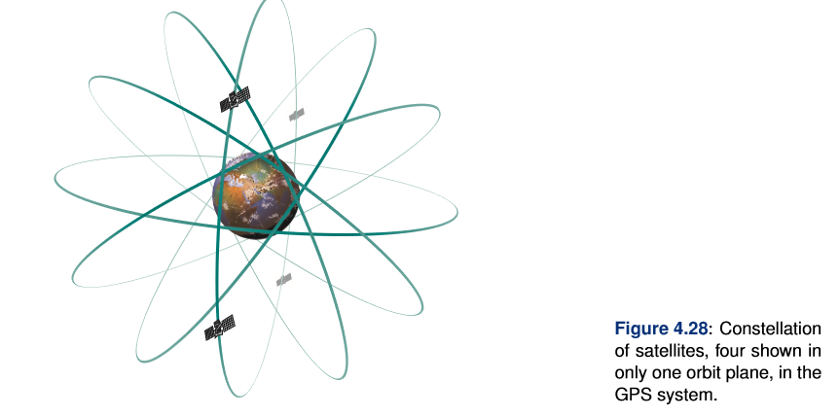
GPS

Slide 32
GLONASS
Global Orbiting Navigational Satellite System
Russian Space Force
GPS better than GLONASS due to its application for civilians
Space segment – 24 satellites organized in 3 orbital planes with an inclination of 64.8 degrees with the equator orbiting altitude – 19130km, period of revolution of 11 hrs 16min.
Radio frequencies – L1 frequency – 1605 MHz ; L2 frequency – 1248 MHz

Slide 33
Galileo
European Union
27 satellites, orbiting in 1 of 3 equally spaced circular orbits at an elevation of 23222 km inclined at 56 degrees with the equator.

Slide 34
Navigation with Indian Constellation (NavIC)
ISRO has established a regional navigation satellite system called Navigation with Indian Constellation (NavIC).
NavIC was earlier known as Indian Regional Navigation Satellite System (IRNSS).
NavIC is designed with a constellation of 7 satellites and a network of ground stations operating 24 x 7.
Three satellites of the constellation are placed in geostationary orbit, at 32.5°E, 83°E and 129.5°E respectively,
four satellites are placed in inclined geosynchronous orbit with equatorial crossing of 55°E and 111.75°E respectively, with inclination of 29° (two satellites in each plane).
The ground network consists of control centre, precise timing facility, range and integrity monitoring stations, two-way ranging stations, etc.
NavIC offers two services: Standard Position Service (SPS) for civilian users and Restricted Service (RS) for strategic users.
NavIC SPS signals are interoperable with the other global navigation satellite system (GNSS) signals namely GPS, Glonass, Galileo

